Slide 1
Orbit Snap: A NASA Space Mission AI Application by Cassy Cormier

Slide 2
Project Overview
Purpose: Making NASA’s visual data more accessible and searchable using AI
Tech Focus: Automating data retrieval, summarization, and keyword tagging

Slide 3

Link to Project prescottcassy/NASA-Space-Mission-AI-App: AI-powered NASA image explorer — summarizes space data, extracts keywords, and visualizes mission data in real time.

Slide 4

Core Technologies Used
Streamlit: For an interactive front-end interface
NASA APOD API: Real-time image and metadata source
NLP Libraries: Hugging Face, spaCy for summarization and keyword extraction
Custom Error Handling: Reusable modules for clean debugging

Slide 5
Modular Code Architecture
Separation of Concerns: API fetcher, NLP processor, README, requirements.txt, error handlings, etc.
Comments & Commits: Clear commenting and commit summaries for collaboration

Slide 6
AI Features
Concise image caption summarization
Auto keyword tagging for improved indexing and insight
Extensible NLP pipeline for future datasets

Slide 7
Output & Visualization
Responsive image display with use_container_width
Captions written for clarity and broader accessibility

Slide 8

Future Enhancements
Visualization upgrades (interactive summaries, tagging heatmaps)
Multi-image retrieval or timeline-based exploration
Integration with other NASA datasets

Slide 9
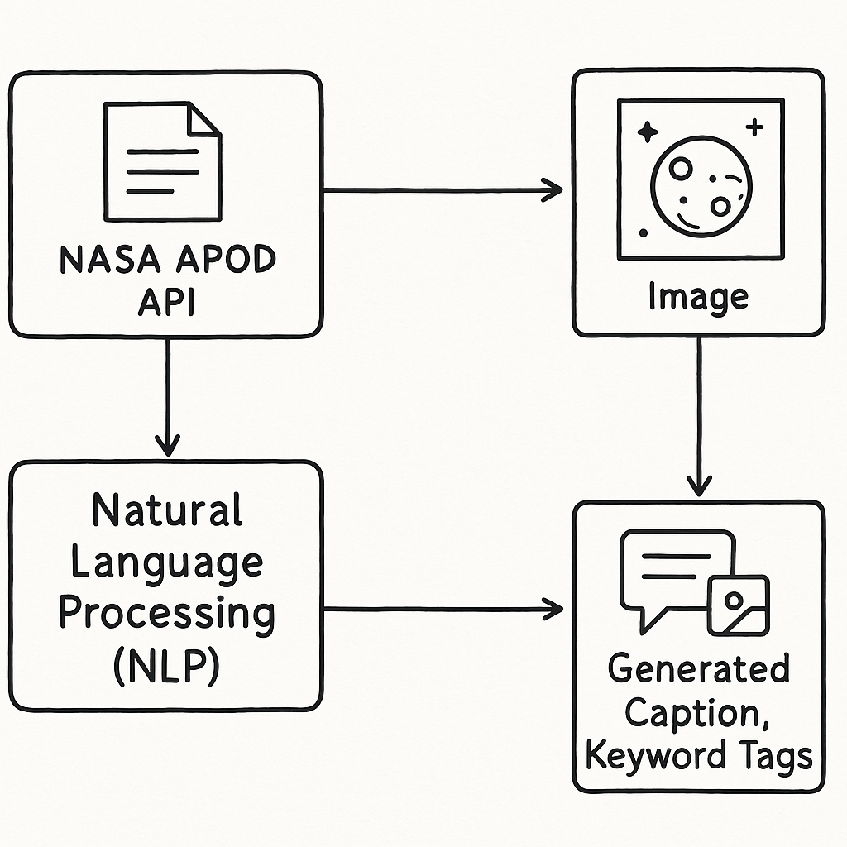
Flow of Data
A visual representiation of how the data moves from API to NLP and then to the front end.

Slide 10

Resources
Copilot for code
ChatGPT for explanations and debugging
Streamlit Documentation
Github for file hosting

Slide 11
Thank you
Cassy Cormier
w215492039@student.hccs.edu

